Slide 1
MBSFN support on AIF2

Slide 2
MBSFN Format for Normal CP
Subframe (1ms) – 30,720T_{s}
Slot (0.5ms) |  |  |  |  |  |  |  |  |  |  |  |  | Slot (0.5ms)
E₀ | N₁ |  |  | N₂ |  | N₃ |  | N₄ |  | N₅ |  | N₆ | E₇ | N₈ |  | N₉ |  | N₁₀ |  | N₁₁ |  | N₁₂ |  | N₁₃
E₀ |  | X₃ |  |  | X₄ |  | X₅ |  | X₆ |  | X₇ |  | X₈ |  | X₉ |  | X₁₀ |  | X₁₁ |  | X₁₂ |  | X₁₃
E₀ | N₁ |  |  |  | X₄ |  | X₅ |  | X₆ |  | X₇ |  | X₈ |  | X₉ |  | X₁₀ |  | X₁₁ |  | X₁₂ |  | X₁₃
Normal
MBSFN1
MBSFN2
G₁ | G’₂
G’’₂ | G’’’₃
  E = (2048 + 160)T_{s} = 2208T_{s}
  N = (2048 + 144)T_{s} = 2192T_{s}
  X = (2048 + 512)T_{s} = 2560T_{s}
Create 14 symbols by splitting the Gaps into 2 pseudo-symbols
  G + G’ = 30720Ts – E – 11X = 352T_{s}
  G’’ + G’’’ = 30720Ts – E – N – 10X = 720Ts

Slide 3
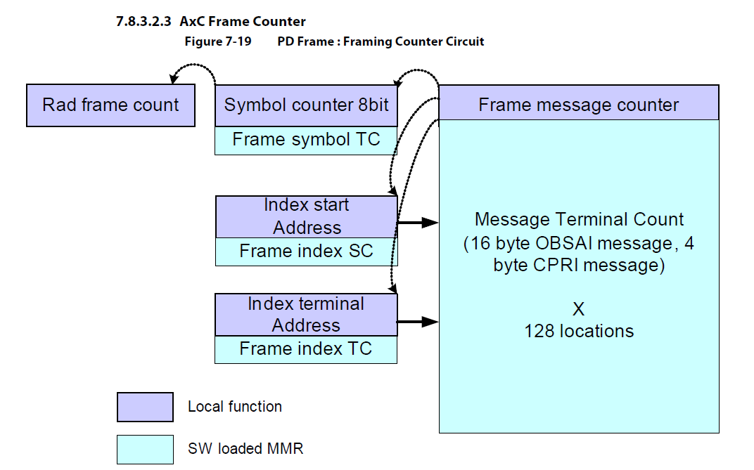
AxC PE Frame Counter
6 Groups
For each group (GrpIdx = 0...5)
  PE_FRM_TC[GrpIdx].FRM_INDEX_SC = 14GrpIdx
  PE_FRM_TC[GrpIdx].FRM_INDEX_TC = 14GrpIdx + 13
  PE_FRM_TC[GrpIdx].FRM_SYM_TC = 14
  PD_FRM_MSG_TC[14GrpIndex+SymIdx].FRM_MSG_TC = SymLen(SymIdx, FrameType)
    Needs to be modified at runtime on transition between Normal and MBSFN Sub-Frames

Slide 4
Message Terminal Count Values
OBSAI
Normal Subframes
    PD_FRM_MSG_TC[14GrpIndex].FRM_MSG_TC = nSamples(E)/4;
  For SimIdx = 1…13
    PD_FRM_MSG_TC[14GrpIndex+Symdx].FRM_MSG_TC = nSamples(N)/4;
MBSFN1 Subframes
    PD_FRM_MSG_TC[14GrpIndex].FRM_MSG_TC = nSamples(E)/4;
    PD_FRM_MSG_TC[14GrpIndex+1].FRM_MSG_TC = nSamples(G)/4;
    PD_FRM_MSG_TC[14GrpIndex+2].FRM_MSG_TC = nSamples(G’)/4;
  For SimIdx = 3…13
    PD_FRM_MSG_TC[14GrpIndex+Symdx].FRM_MSG_TC = nSamples(X)/4;
MBSFN2 Subframes
    PD_FRM_MSG_TC[14GrpIndex].FRM_MSG_TC = nSamples(E)/4;
    PD_FRM_MSG_TC[14GrpIndex+1].FRM_MSG_TC = nSamples(N)/4;
    PD_FRM_MSG_TC[14GrpIndex+2].FRM_MSG_TC = nSamples(G’’)/4;
    PD_FRM_MSG_TC[14GrpIndex+3].FRM_MSG_TC = nSamples(G’’’)/4;
  For SimIdx = 4…13
    PD_FRM_MSG_TC[14GrpIndex+Symdx].FRM_MSG_TC = nSamples(X)/4;

Slide 5
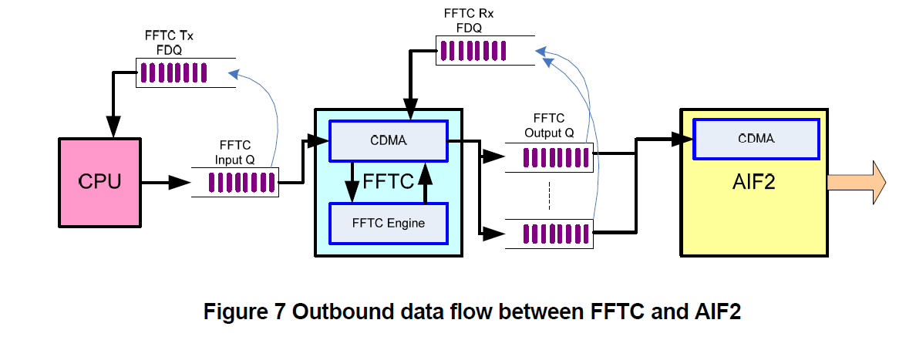
FFTC – AIF2 Interfacing
Before the transmission of each symbol, AIF2 requests a monolithic descriptor containing antenna data do be transmitted
The GAP pseudo-symbols need associated descriptors with zero antenna data
The AIF2 descriptors are provided by FFTC output
The CPU provides frequency domain descriptors at the FFTC input, one per symbol, including zero-data descriptors for the GAP

Slide 6
Gap Pseudo-Symbols
Gap constrains:
  Multiple of 4 samples
  Size supported by FFTC
 | G = G’ | FFT size | CP length | G’’ = G’’’ |  | FFT size | CP length
20MHz | 176 | 128 | 48 | 360 |  | 256 | 104
10MHz | 88 | 64 | 24 | 180 |  | 128 | 52
5MHz | 44 | 32 | 12 | G’’=88 | G’’’=92 | 64 | 24 | 28

Slide 7
Message Terminal Count LUT (20MHz*)
 | Normal | MBSFN 1 | MBSFN2
0 | 552 | 552 | 552
1 | 548 | 44 | 548
2 | 548 | 44 | 64
3 | 548 | 640 | 64
4 | 548 | 640 | 640
5 | 548 | 640 | 640
6 | 548 | 640 | 640
7 | 552 | 640 | 640
8 | 548 | 640 | 640
9 | 548 | 640 | 640
10 | 548 | 640 | 640
11 | 548 | 640 | 640
12 | 548 | 640 | 640
13 | 548 | 640 | 640
*Note: For 10MHz and 5MHz, divide the values in the table by 2 and 4 respectively

Slide 8
AT Interrupts
Assume the AT interrupts are generated once every symbol of a Normal CP sub-frame (non-MBSFN)
The MBSFN symbols are asynchronous with these interrupts (we do not reprogram AT)
The CPU needs to determine what MBSFN symbol to compute on each AT interrupts.
The pattern can be irregular; it may affect the memory usage
0 | 1 | 2 3 | 4 | 5 | 6 | 7 | 8 | 9 | 10 | 11 | 12 | 13
E₀ | N₁ |  | X₄ | X₅ | X₆ | X₇ | X₈ | X₉ | X₁₀ | X₁₁ | X₁₂ | X₁₃
0 | 1 | 2 | 3 | 4 | 5 | 6 | 7 | 8 | 9 | 10 | 11 | 12 | 13
E₀ | N₁ | N₂ | N₃ | N₄ | N₅ | N₆ | E₇ | N₈ | N₉ | N₁₀ | N₁₁ | N₁₂ | N₁₃

Slide 9
Message Terminal Count Update (1)
It is unsafe to update Message Terminal Count within some time regions
Interrupt associated with symbol counter N can update Terminal Count with offset within the group, between (N+1)%14 and (N-3+14)%14
0 | 1 | 2 3 | 4 | 5 | 6 | 7 | 8 | 9 | 10 | 11 | 12 | 13
E₀ | N₁ |  | X₄ | X₅ | X₆ | X₇ | X₈ | X₉ | X₁₀ | X₁₁ | X₁₂ | X₁₃
0
1
2
3
4
5
6
13
0 | 1 | 2 | 3 | 4 | 5 | 6 | 7 | 8 | 9 | 10 | 11 | 12 | 13
E₀ | N₁ | N₂ | N₃ | N₄ | N₅ | N₆ | E₇ | N₈ | N₉ | N₁₀ | N₁₁ | N₁₂ | N₁₃

Slide 10
Message Terminal Count Update (2)
Carriers are misaligned by K symbols
Interrupt N can update Terminal Count with offset (N+1+K)%14 within the group
K=2
0 | 1 | 2 3 | 4 | 5 | 6 | 7 | 8 | 9 | 10 | 11
E₀ | N₁ |  | X₄ | X₅ | X₆ | X₇ | X₈ | X₉ | X₁₀ | X₁₁
0
1
4
5
2
3
6
11
0 | 1 | 2 | 3 | 4 | 5 | 6 | 7 | 8 | 9 | 10 | 11 | 12 | 13
E₀ | N₁ | N₂ | N₃ | N₄ | N₅ | N₆ | E₇ | N₈ | N₉ | N₁₀ | N₁₁ | N₁₂ | N₁₃

Slide 11
Message Terminal Count Update
Procedure
The AT symbol event interrupt associated with symbol counter N can update Terminal Count with offset between (N+1+K)%14 and (N+11)%14 within the group.
It is best to pick the middle of the range: for K=3, symIdx = (N+8)%14 is recommended
Updating Procedure
In the AT symbol event ISR
  Read AT symbol counter N
  Compute symIdx = (N+8)%14
  Pick the value with offset symIdx from Message Terminal Count LUT corresponding to the subframe format symIdx of and write it to the AIF2
PD_FRM_MSG_TC[14GrpIndex+symIdx].FRM_MSG_TC =
    Message_Terminal_Count_LUT[format][symIdx]

